Slide 1
CAT PRACTICE • PROJECT BASED ASSESSMENT
MOTHERLAND PHARMACY
MANAGEMENT SYSTEM
A Console-Based Pharmacy Management System Developed in C with a MySQL Database
Submitted by: Thierry NDAYISHIMIYE
Institution: Rwanda Polytechnic (RP) – Karongi College
Tools: C Programming Language, MySQL, Dev-C++ IDE
Date: August 2026

Slide 2
SECTION I
Description of the Project
KEY MODULES
The Motherland Pharmacy Management System is a console-based application developed in the C programming language, backed by a MySQL relational database, and built/run using the Dev-C++ IDE. It computerises the daily operations of a community pharmacy — replacing manual, paper-based record keeping with a fast, centralised digital system.
database.c
Database connection
login.c
Authentication
medicine.c
Inventory management
sale.c
All business logic is organised into independent modules, with a shared ui.c helper centralising console formatting, prompts and input validation for a consistent professional look throughout every menu.
Sales transactions
supplier.c / customer.c
Partner records
report.c
Business reports
Motherland Pharmacy Management System
2

Slide 3
SECTION II
Problem Statement
CHALLENGES AT MOTHERLAND PHARMACY
HOW THE SYSTEM RESPONDS
Manual, paper-based stock and sales records are slow and error-prone
Difficult to track medicines nearing expiry before they are sold
No reliable way to detect low stock before items run out
Sales, customer and supplier data are scattered and hard to audit
No real-time reports to support fast, accurate business decisions
The Motherland Pharmacy Management System was developed to directly solve these problems: it provides a single, database-driven application that automates inventory control, blocks the sale of expired medicine, records every transaction with full traceability, and instantly generates the operational reports management needs to make informed, timely decisions.
Motherland Pharmacy Management System
3

Slide 4
SECTION III
Objectives
GENERAL OBJECTIVE
To design and implement a console-based Pharmacy Management System using C and MySQL that automates inventory control, sales processing, and reporting for Motherland Pharmacy.
SPECIFIC OBJECTIVES
1
2
3
Secure login & user-account module restricting access to authorised staff
Inventory module to add, search, update and delete medicine records
Transactional sales module that updates stock and blocks expired medicine
4
5
Relational MySQL database linking medicines, sales, users, customers & suppliers
Real-time reports (low stock, expiry, top sellers) for decision-making
Motherland Pharmacy Management System
4

Slide 5
SECTION IV
Functional Requirements
Function
Description
Authentication
Staff log in with username & password (login())
User Management
Add / view / search / update / delete staff accounts
Medicine Management
Add / view / search / update / delete medicine records
Supplier Management
Add / view / search / update / delete supplier records
Customer Management
Add / view / search / update / delete customer records
Sales Processing
Create sale, view/search history, receipt, delete (transaction-safe)
Reporting
Daily, low-stock, expiry, top-selling, monthly & value reports
System Overview
Dashboard summary of overall pharmacy performance
Motherland Pharmacy Management System
5

Slide 6
SECTION IV
Non-Functional Requirements
Reliability
Performance
Security
Sales run inside DB transactions (BEGIN / COMMIT / ROLLBACK) keeping stock and sales consistent
Direct, indexed SQL queries keep search, listing and reporting fast
Login-gated access; inputs escaped before use in SQL statements
Usability
Portability
Maintainability
Consistent menu-driven console UI with clear prompts & messages (ui.c)
Runs on Windows via Dev-C++ with MySQL Connector/C
Modular codebase split by feature for easy debugging & extension
Motherland Pharmacy Management System
6

Slide 7
SECTION V
Algorithm Design — Pseudocode
Core logic of the sellMedicine() function — the pharmacy's most critical transaction:
BEGIN SellMedicine
Select customer (or walk-in) and build a shopping cart
FOR each medicine chosen:
IF expired OR quantity > stock THEN reject item
ELSE add to cart and update grand total
IF cart is empty THEN cancel sale
START TRANSACTION
INSERT sale header (sales)
INSERT each line item (sale_items)
UPDATE medicines SET quantity = quantity − sold
IF all steps succeed THEN COMMIT and print receipt
ELSE ROLLBACK and show error
END SellMedicine
Motherland Pharmacy Management System
7

Slide 8
SECTION V
Algorithm Design — Flowchart
The flowchart traces the sell-medicine process from customer/medicine selection through stock validation, cart building, and the final database transaction that commits the sale or rolls it back on failure.
Motherland Pharmacy Management System
8

Slide 9
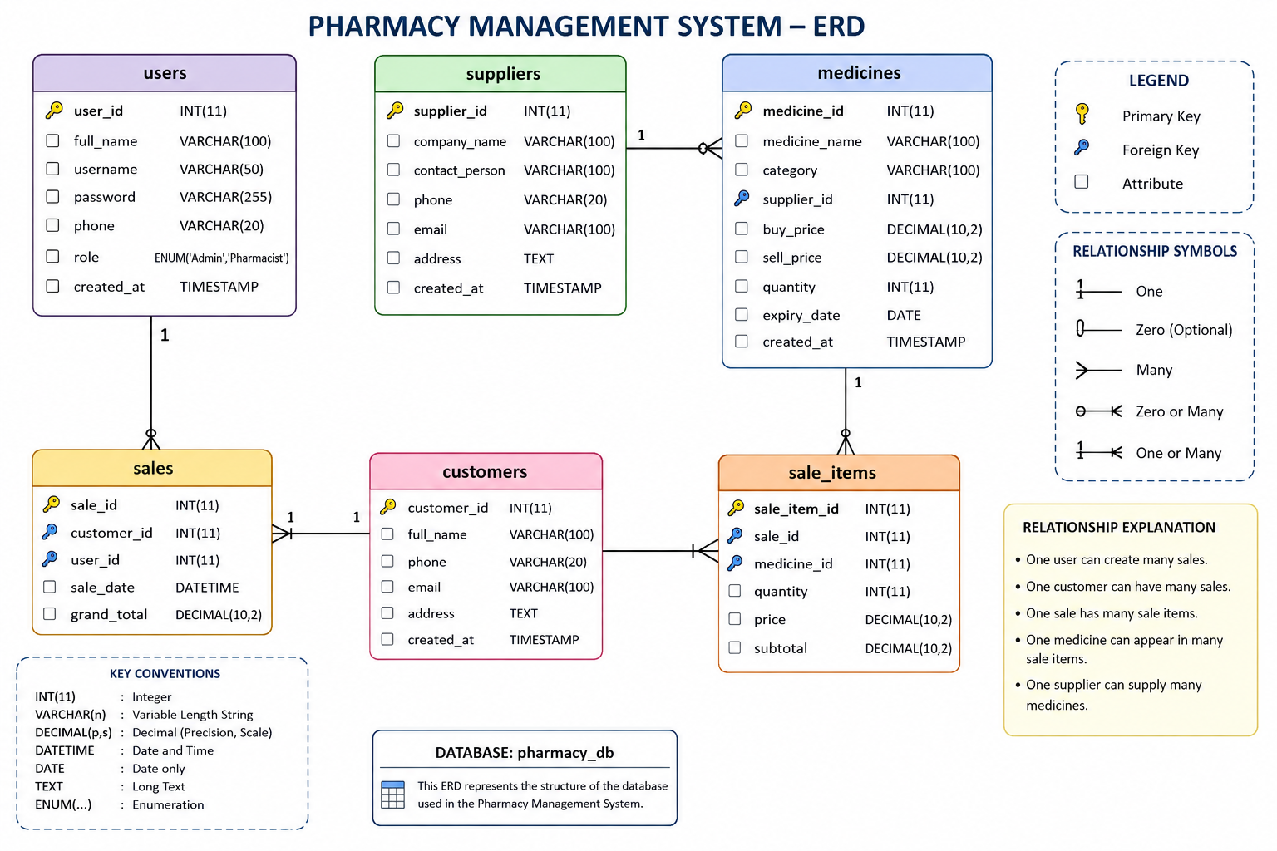
SECTION VI
Database Design — ERD
RELATIONSHIPS
One user creates many sales
One customer can have many sales
One sale has many sale_items
One medicine appears in many sale_items
One supplier supplies many medicines
6 tables — pharmacy_db
users · medicines · suppliers · customers · sales · sale_items
Motherland Pharmacy Management System
9

Slide 10
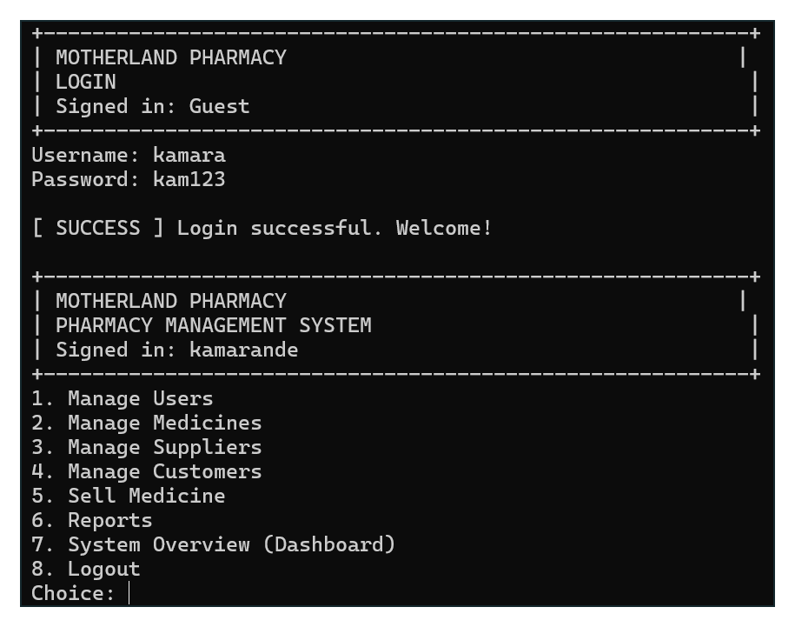
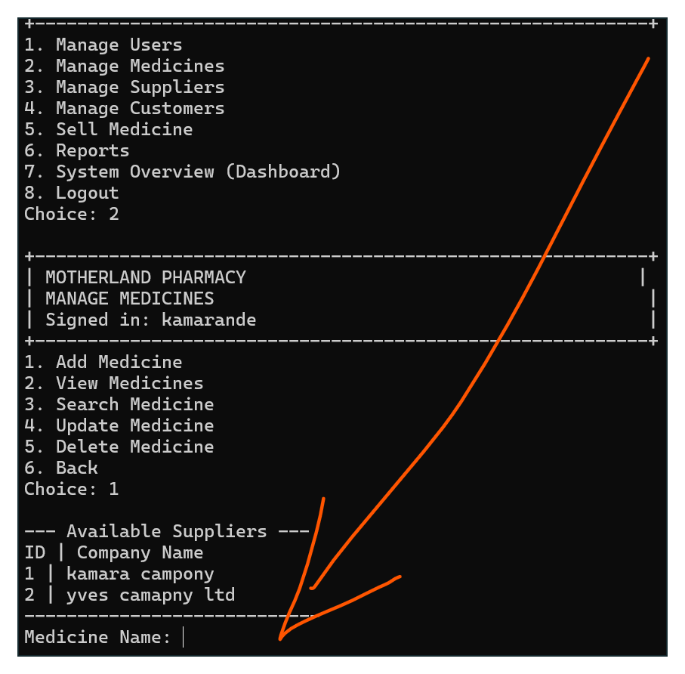
SECTION VII
System Implementation
Login & Main Dashboard
Managing Medicines (Inventory)
Motherland Pharmacy Management System
10

Slide 11
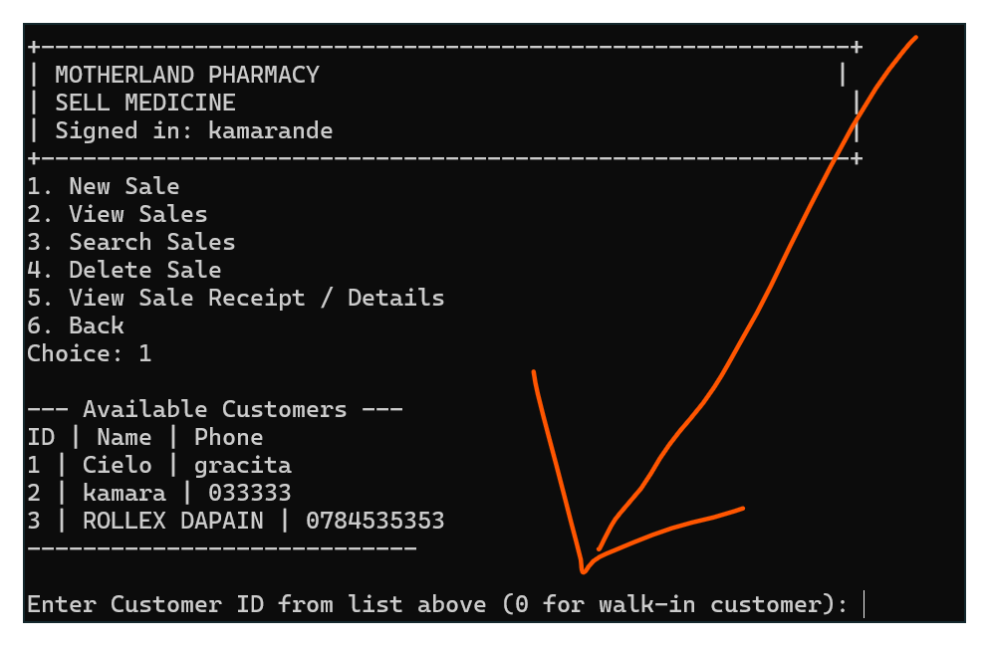
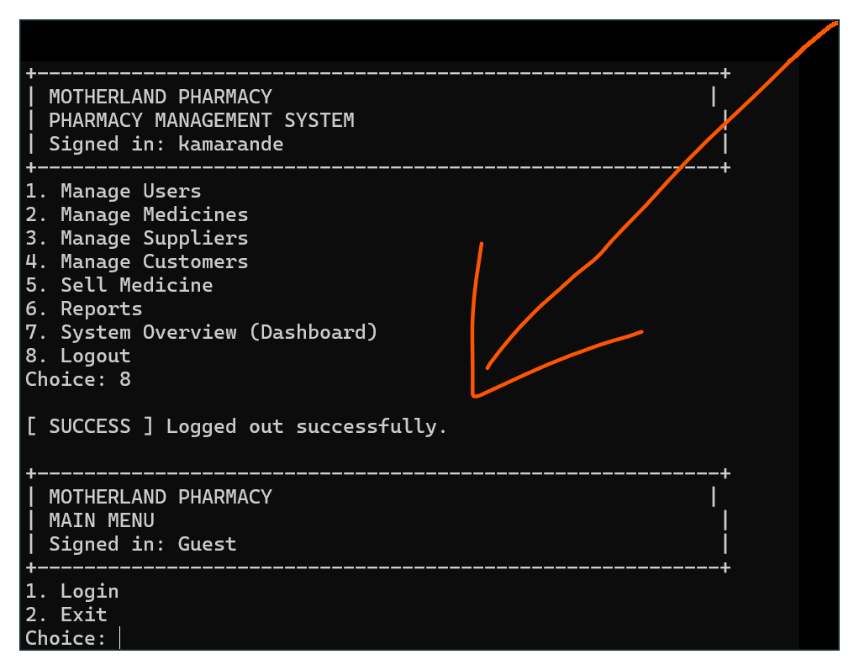
SECTION VII
System Implementation (cont'd)
Selling Medicine
Logging Out
Motherland Pharmacy Management System
11

Slide 12
SECTION VIII
Conclusion
The Motherland Pharmacy Management System successfully demonstrates a complete, working solution to the operational problems faced by the pharmacy. Built in C with a MySQL backend and run through Dev-C++, it provides secure staff login, full inventory management, transactional sales processing that automatically updates stock and blocks expired medicine, supplier and customer record keeping, and a wide range of operational reports.
Testing of the compiled application confirmed that all major modules — authentication, medicine management, sales, and reporting — function correctly and update the pharmacy_db database consistently, achieving both the general and specific objectives of the project.
Motherland Pharmacy Management System
12

Slide 13
SECTION VIII
Recommendations
1
Strengthen Security
Hash passwords (e.g. bcrypt) and use prepared/parameterised SQL statements throughout
2
Backup & Export
Add automated database backups and CSV/PDF export of sales and stock reports
3
Graphical Interface
Replace the console UI with a GUI or web-based front end for easier daily use
4
Data Integrity
Enforce foreign-key constraints and guard against deleting referenced records
5
Role-Based Access
Give Admin and Pharmacist accounts distinct permissions within the system
Motherland Pharmacy Management System
13

Slide 14
THANK YOU
Questions & Discussion
Thierry NDAYISHIMIYE — Rwanda Polytechnic (RP) Karongi College
Motherland Pharmacy Management System — C & MySQL

